Slide 1
Lecture 17: Trees part 2 Fall 2016
Today:
Go over exam 2
Search for value
Insert nodes into BST
Delete nodes from BST
Get ready for lab – node deletion

Slide 2
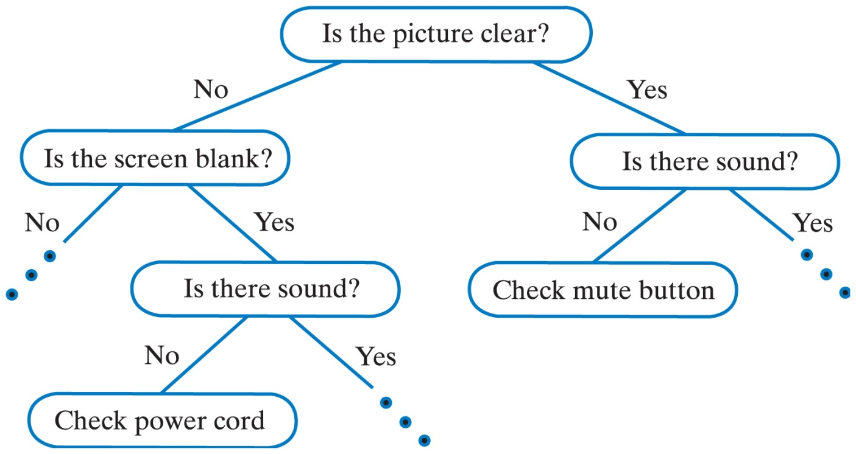
Decision Trees
A decision tree can be the basis of an expert system
Helps users solve problems, make decisions

Slide 3
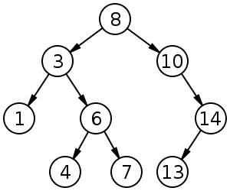
Review
What insertion order gives the following tree?
Is there more than one order?
What if they are inserted in : 1,3,4,6,7,8,10,13,14 order ?

Slide 4
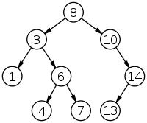

Slide 6
Node deletion
Three cases:
Node has No children (leaf node)
Node has One child
Subcase left child only
Subcase right child only
Node has Two children
Two solutions, we will pick one

Slide 7
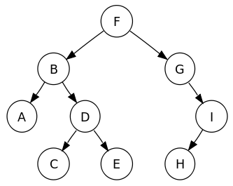
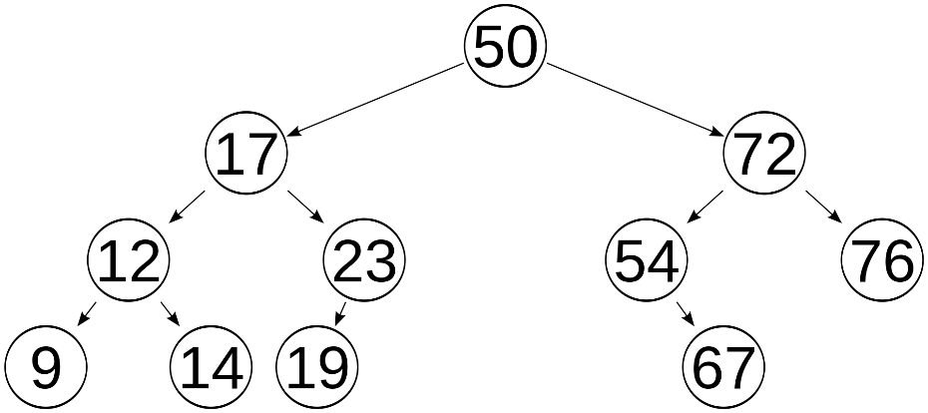
Deleting a Node:
Case 1 (Leaf) : Set link from parent of node_to_be_deleted to NULL.
Case 2: (Node has one child): Set link from parent of node_to_be_deleted to child of node_to_be_deleted.
Case 3: Copy value of inorder successor node into node_to_be_deleted. Then delete the inorder successor node, which will be Case 1 or Case 2.

Slide 8
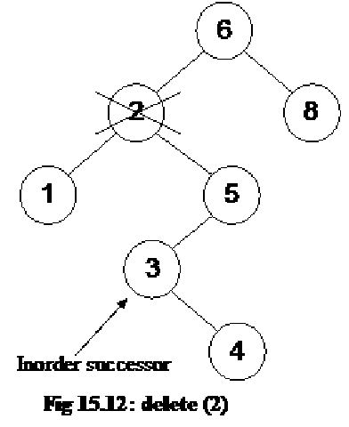
More inorder successor examples

Slide 9
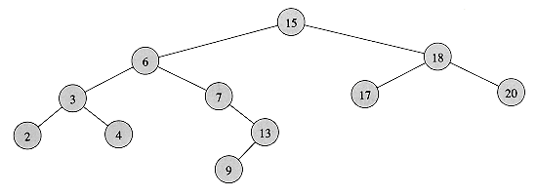
More inorder successor examples

